Slide 1

Principles of Web Design 6th Edition
Web Forms Development& Validation

Slide 2
Introduction
remember:
HTML to define the content of web pages.
CSS to specify the layout of web pages.
JavaScript to program the behavior of web pages.

Slide 3
Objectives
When you complete this chapter, you will be able to:
Understand how forms work
Use the <form> element
Create input objects
Validate the form on events.

Slide 4
Understanding How Forms Work
Forms let you build interactive web pages that collect information from a user and process it on the web server
The HTML form is the interface for the user to enter data
The data is processed by applications that reside on the web server

Slide 5
Understanding How Forms Work
The data-processing software can then work with the data and send a response back to the user
The user enters data via an HTML form

Slide 6
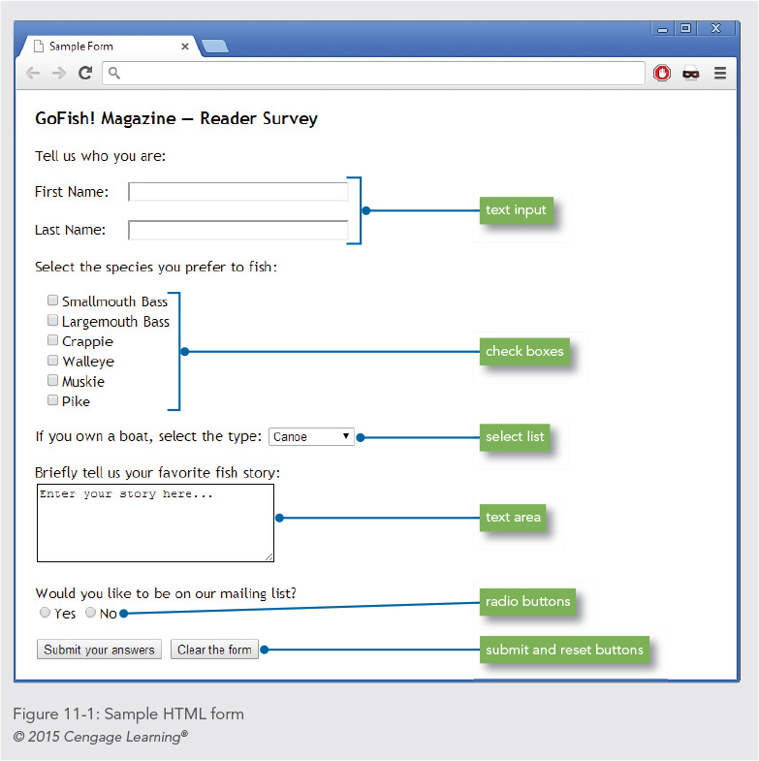

Slide 7
Using the <form> element
The <form> element is the container for creating a form
A variety of attributes describe how the form data will be processed

Slide 8
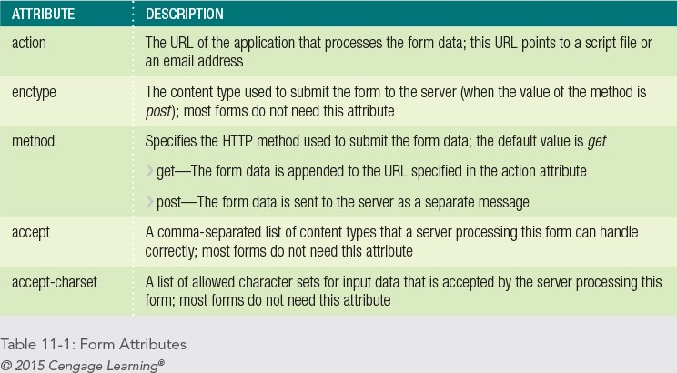

Slide 9
Using the <form> element
The following code shows a typical <form> element:
<form method="post"
action="https://signup.website.com/register.asp">

Slide 10
Using get or post
The difference between get and post is the way the data is sent to the server
method=“get”: this method sends the form information by including it in the URL
method=“post”: this method sends the form information securely to the server within the message body

Slide 11
Using the mailto Action
Lets you collect data from a form and send it to any e-mail address
<form action="mailto:joel@joelsklar.com"
method="post" enctype="text/plain">

Slide 12
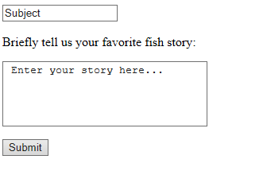
Using the mailto Action
<!DOCTYPE html>
<html>
<body>
<form action="MAILTO:joel@joelsklar.com " method="post" enctype="text/plain">
<input type="text" name="Subject" value="Subject">
<p>Briefly tell us your favorite fish story:</p>
<p>
<textarea name="fishstory" rows="5" cols="30"> Enter your story here... </textarea>
</p>
<input value="Submit" type="submit">
</form>
</body>
</html>

Slide 13
Creating Input Objects
The <input> element defines many of the form input object types
The type attribute specifies the type of input object
Required attribute makes the element mandotry to be filled before submitting the form.

Slide 14
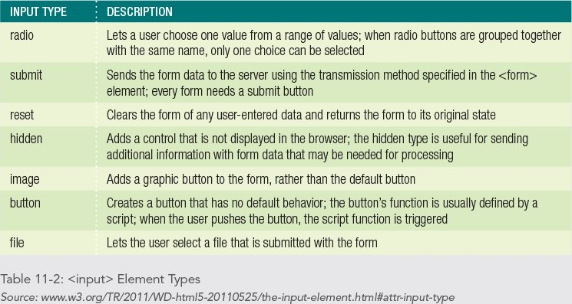

Slide 15
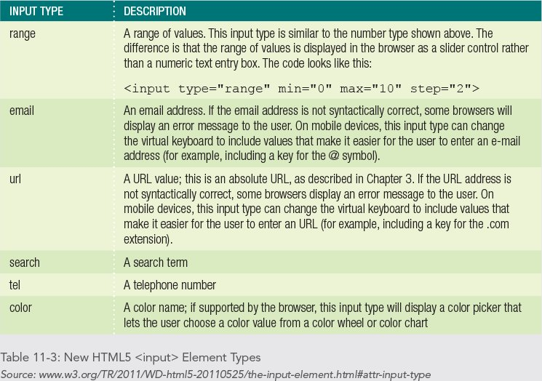

Slide 16
Labeling Form Elements
The <label> element lets you create a caption for an input element
Lets you extend the clickable area of a form element
Required, usually first name is mandatory.
<p>
<label class="username" >First Name:</label>
<input type="text“ required name="firstname"
size="35" maxlength="35" />
</p>

Slide 17
Labeling Form Elements
To make the text clickable, you associate the <label> element with the <input> element by using the for and id attributes
<p>
<label class="username" for="First Name">
First Name:</label>
<input type="text" required name="fi rstname" id="First Name"
size="35" maxlength="35" />
</p>

Slide 18
Creating Text Boxes
The text box is the most commonly used form element
<input type="text" name="firstname" size="20" maxlength="35" value="First Name">

Slide 19
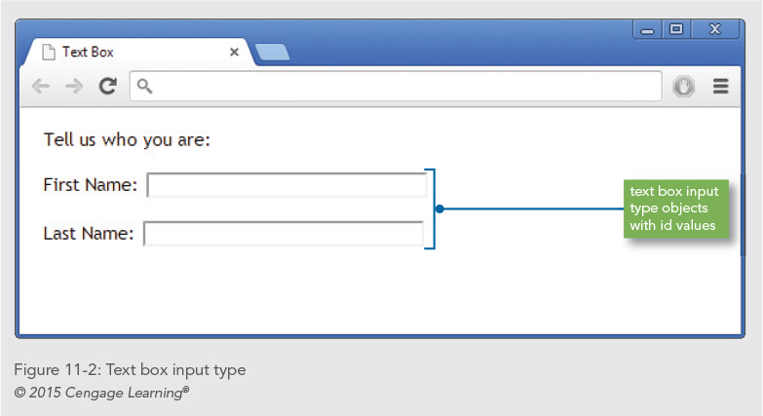

Slide 20
Creating Check Boxes
Check boxes are an on/off toggle that the user can select
<input type="checkbox" name="species" value="smbass"> Smallmouth Bass

Slide 21
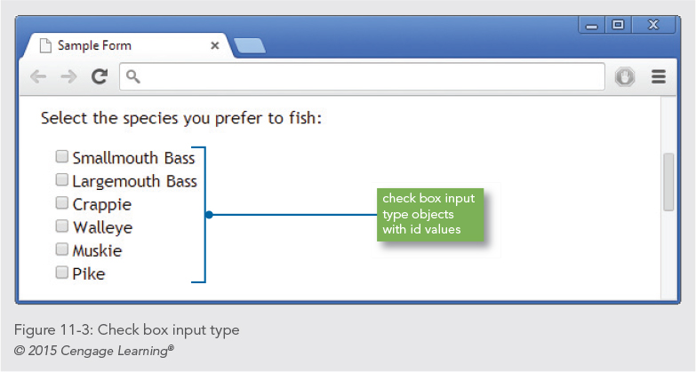

Slide 22
Creating Radio Buttons
Radio buttons are like check boxes, but only one selection is allowed
<p>Would you like to be on our mailing list?</p>
<p><input type="radio" name="list" value="yes"
id="Yes" />
<label for="Yes">Yes</label>
<input type="radio" name="list" value="no"
id="No" />
<label for="No">No</label>
</p>

Slide 23
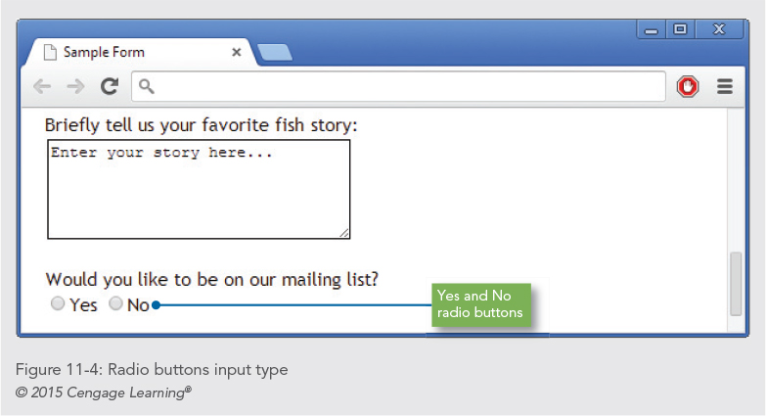

Slide 24
Creating Submit & Reset Buttons
The submit and reset buttons let the user choose whether to send the form data or start over
<input type="submit" value="Submit your answers">
<input type="reset" value="Clear the form">

Slide 25
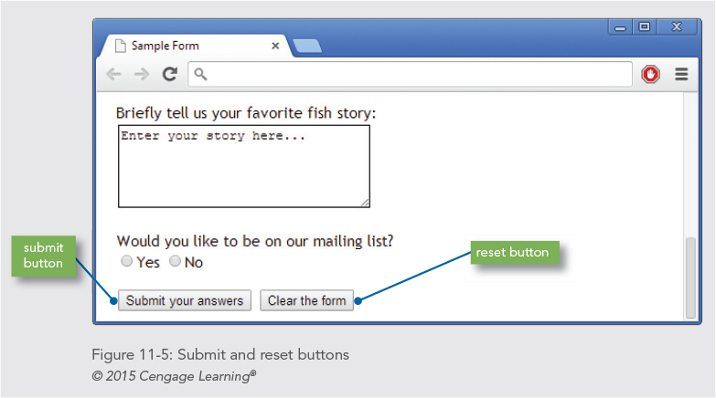

Slide 26
Creating an Image for the Submit Button
You can choose an image file and use it instead of the default submit button
<input type="image" src="submit.gif" alt="submit button">

Slide 27
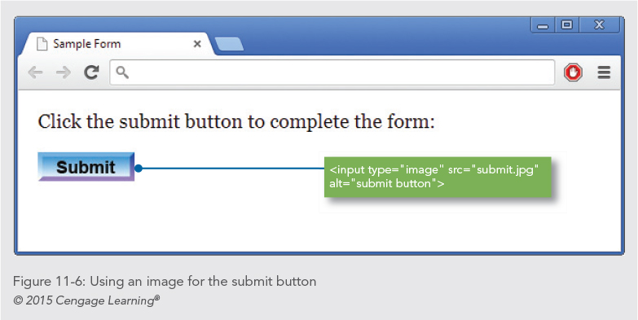

Slide 28
Letting the User Submit a File
Users can select a file on their own computer and send it to the server
<p>Use the browse button to select your file:</p>
<p><input type="file" size="30“></p>

Slide 29
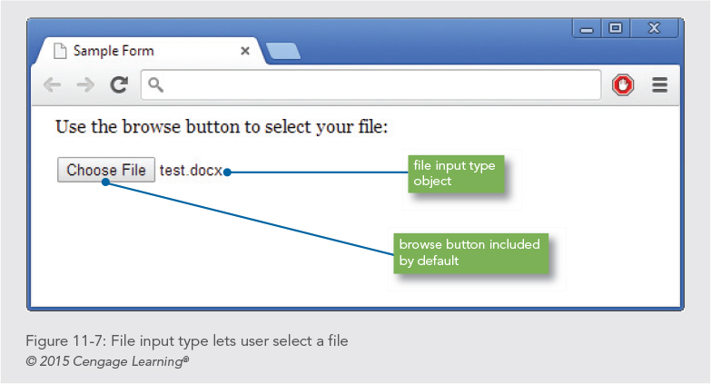

Slide 30
Creating a Password Entry Field
The password input box works like the text input, but the entered text is hidden by asterisks
<p>Enter your user name and password:</p>
<p>
User Name: <input type="text" size="30" />
Password: <input type="password" size="30" />
</p>

Slide 31
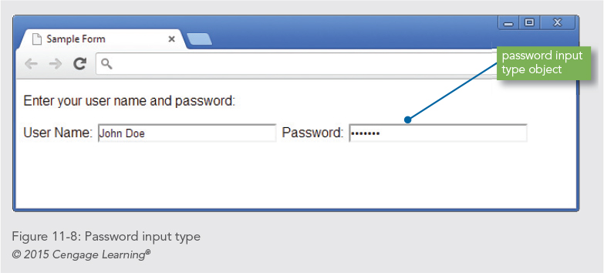

Slide 32
Creating a Password Entry Field
The password input box works like the text input, but the entered text is hidden by asterisks
<p>Enter your user name and password:</p>
<p>
User Name: <input type="text" size="30" />
Password: <input type="password" size="30" />
</p>

Slide 33
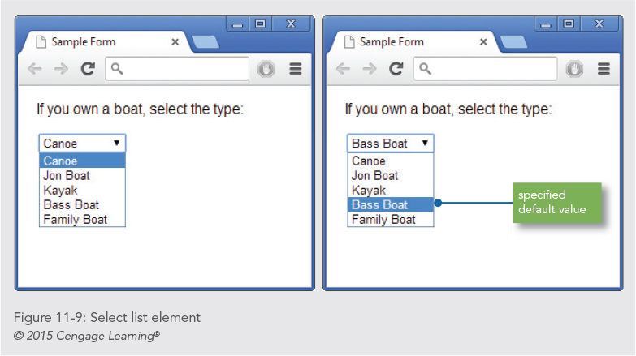

Slide 34
Using the <select> Element
The <select> element lets you create a list box or scrollable list of selectable options
<select name="boats">
<option>Canoe</option>
<option>Jon Boat</option>
<option>Kayak</option>
<option>Bass Boat</option>
<option>Family Boat</option>
</select>

Slide 35
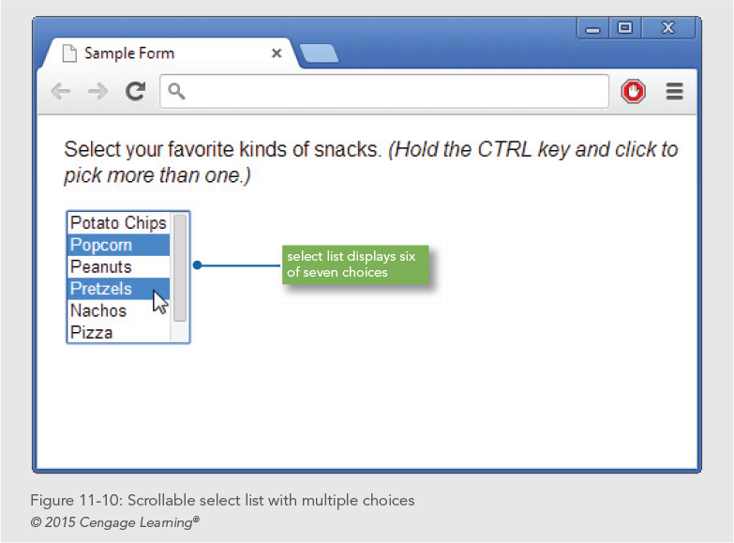

Slide 36
Using the <select> Element
You can choose to let the user pick multiple values from the list by adding the multiple attribute
<select name="snacks" multiple size="6">
<option>Potato Chips</option>
<option>Popcorn</option>
<option>Peanuts</option>
<option>Pretzels</option>
<option>Nachos</option>
<option>Pizza</option>
<option>Fries</option>
</select>

Slide 37
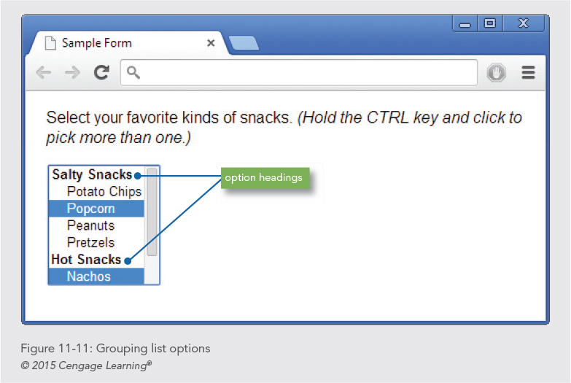

Slide 38
Using the <select> Element
You group and label sets of list options with the <optgroup> element and label attribute
<optgroup label="Salty Snacks">
<option>Potato Chips</option>
<option>Popcorn</option>
<option>Peanuts</option>
<option>Pretzels</option>
</optgroup>

Slide 39
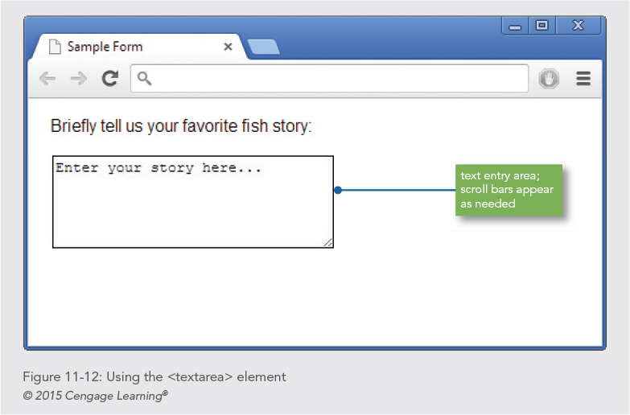

Slide 40
Using the <textarea> Element
The <textarea> element lets you create a larger text area for user input
<p><b>Briefly tell us your favorite fish story:</b><br>
<textarea name="fishstory" rows="5" cols="30">
Enter your story here...
</textarea>
</p>

Slide 41
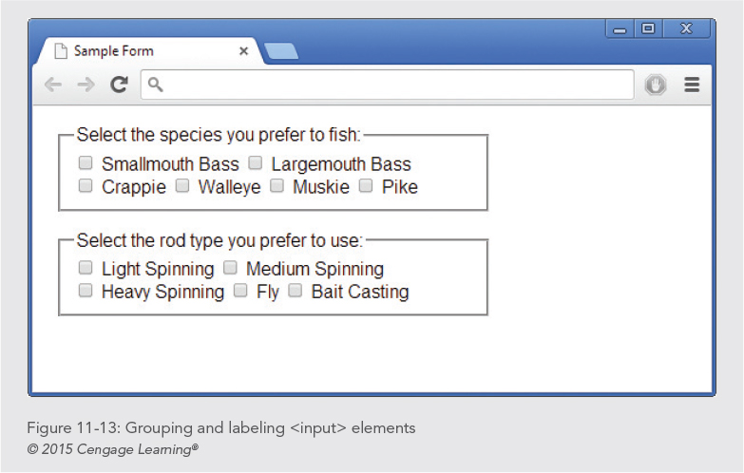

Slide 42
Creating Input Groupings
You can use the <fieldset> and <legend> elements to create groupings of different types of input elements

Slide 43
Creating Input Groupings
<fieldset>
<legend><b>Select the species you prefer to fish:</b></legend>
<input type="checkbox" name="species" value="smbass"> Smallmouth Bass
<input type="checkbox" name="species" value="lgbass"> Largemouth Bass <br>
<input type="checkbox" name="species" value="pike"> Pike
</fieldset>

Slide 44
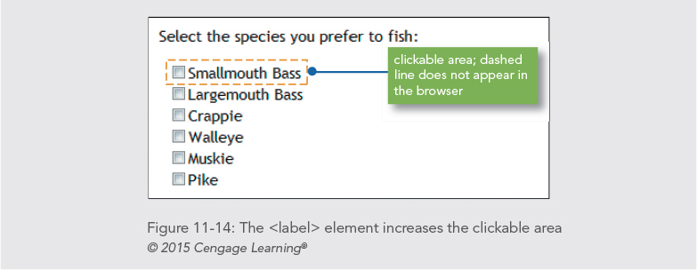

Slide 45
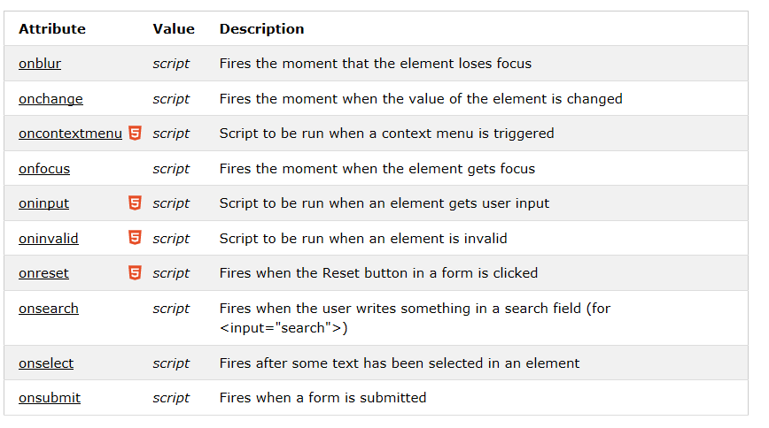
Forms Events
~http://www.w3schools.com/tags/ref_eventattributes.asp

Slide 46
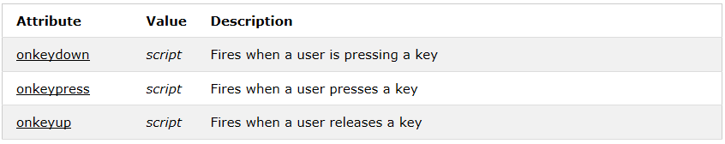
Keyboard Events
~http://www.w3schools.com/tags/ref_eventattributes.asp

Slide 47
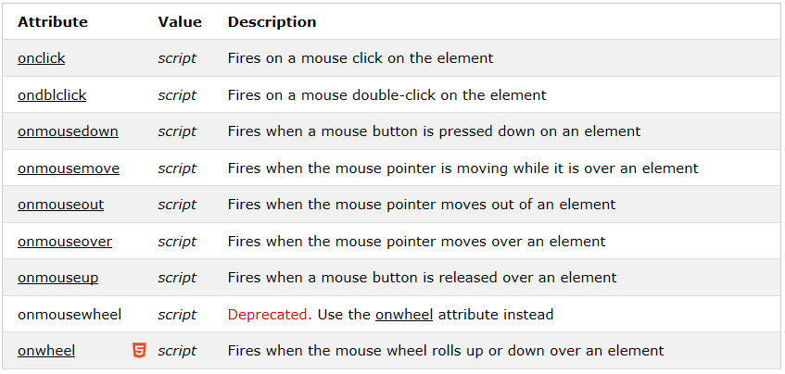
Mouse Events
~http://www.w3schools.com/tags/ref_eventattributes.asp

Slide 48
Summary
Choose the right form elements based on the data you want to collect
A form element has attributes that describe how the form data is processed
You need a server application to process your form data
The <fieldset> and <legend> elements let you create more visually appealing forms

